Slide 1
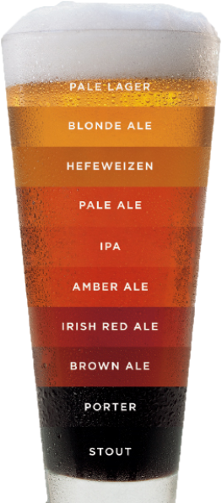
Brewery Investigation in the United States
Duy Nguyen & Garrett Shankel

Slide 2
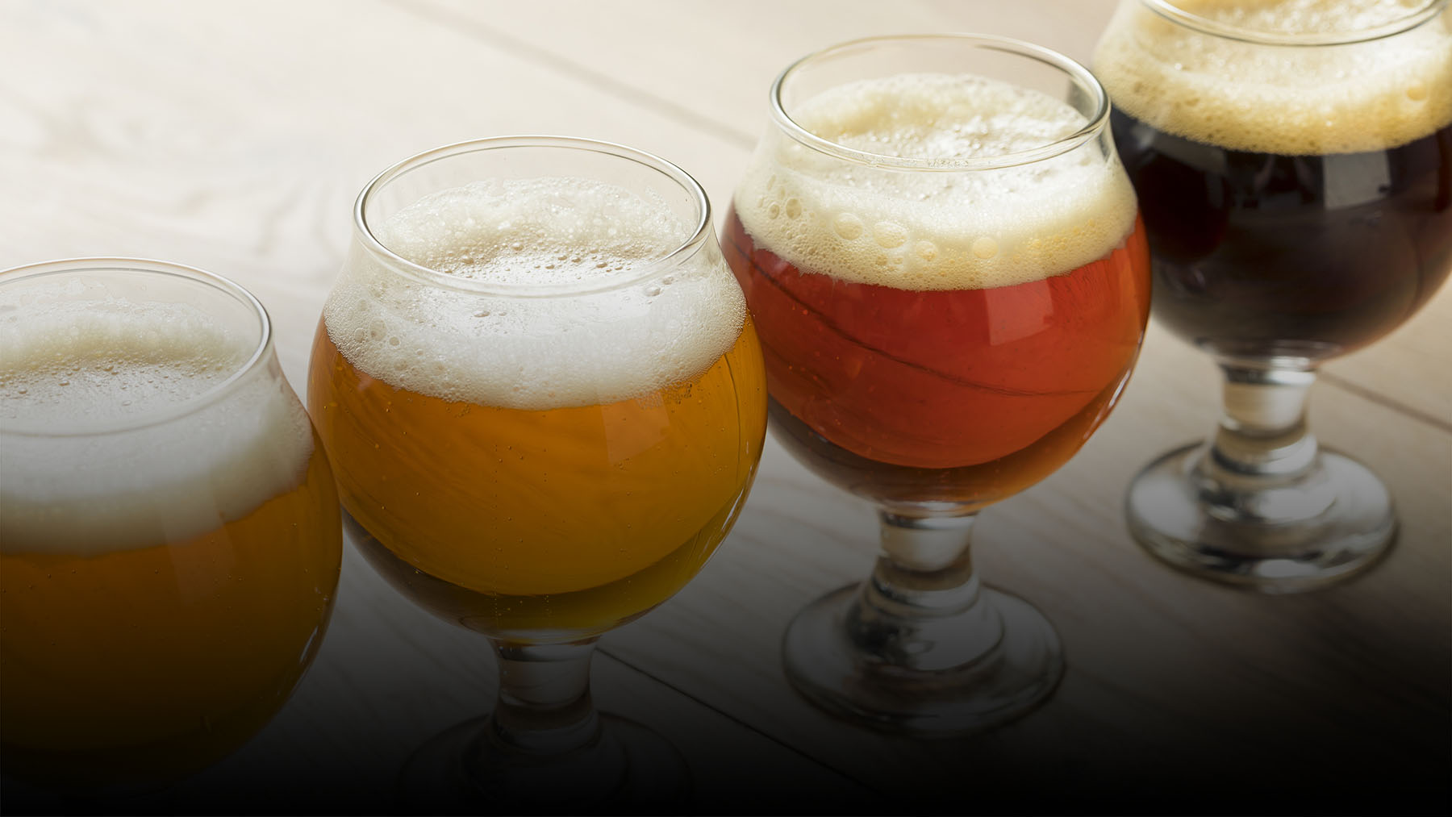
Scope of Discussion
Overview of Data Used
Brewery Count per State in the US
Beer Descriptors per State
Nationwide Statistics of ABV
Relationship between ABV and IBU
Top 10 Beer Styles

Slide 3
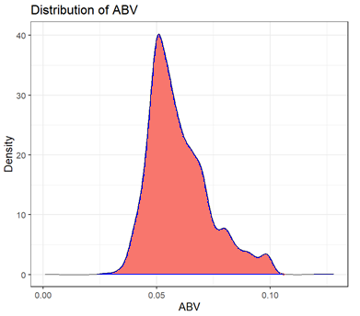
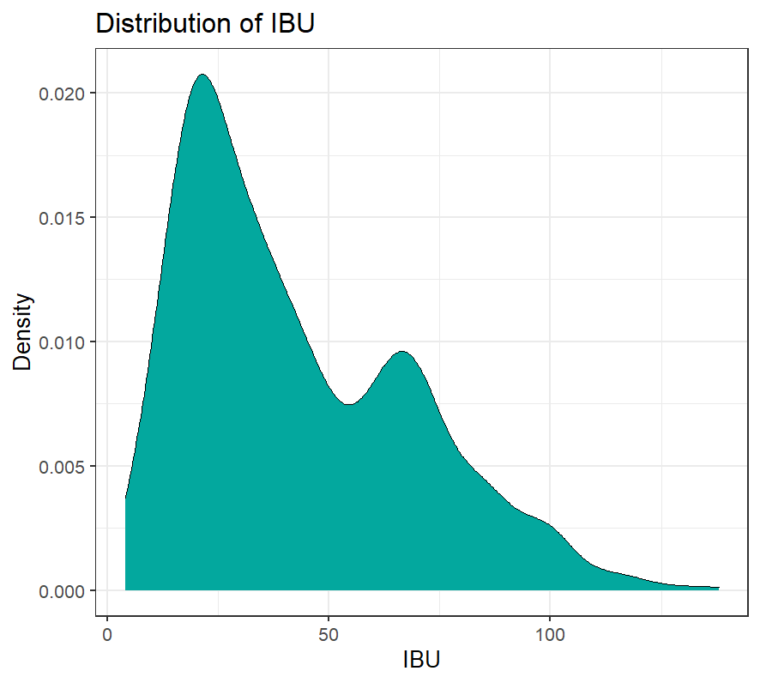
Overview of Data Used
Missing Values in Beers and Brewery Data
Observations
62 out of 2410 entries missing for ABV
1005 out of 2410 entries missing for IBU
Two inferences made on ABV and IBU
Imputed missing ABV values using means of the ABV data.
Imputed missing IBU values using medians of the IBU data.

Slide 4
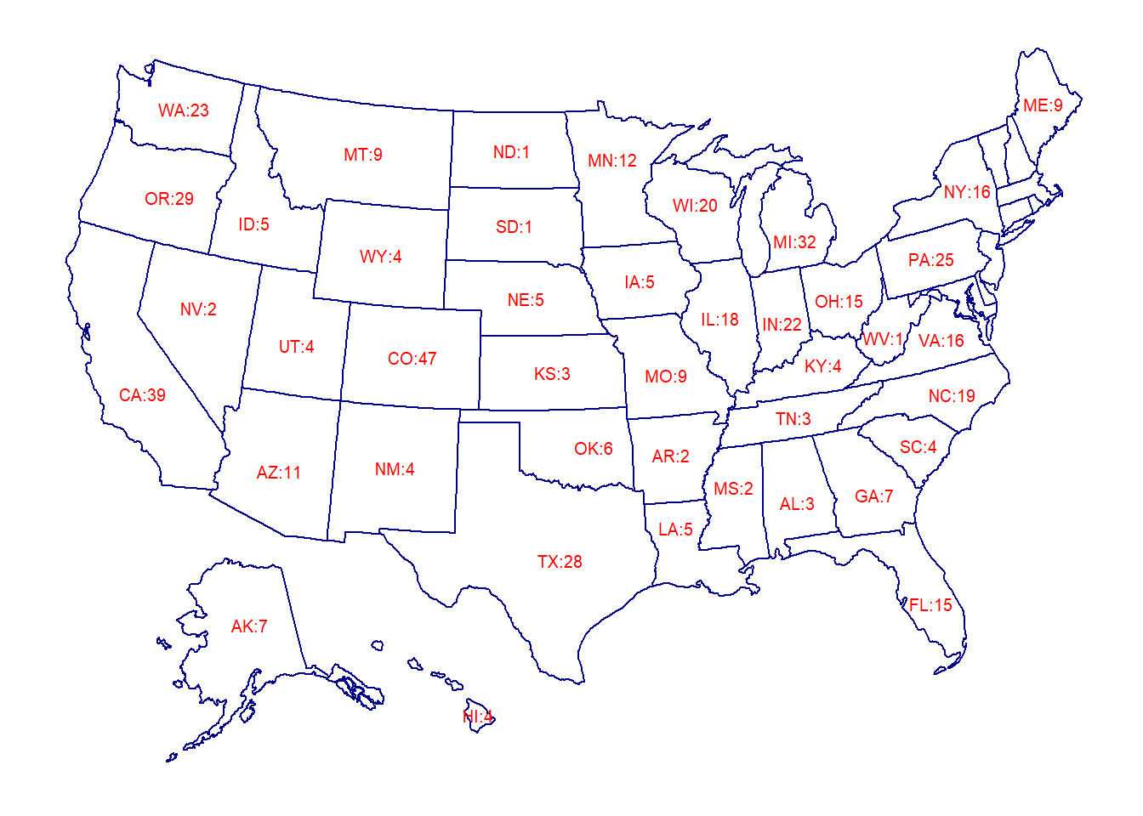
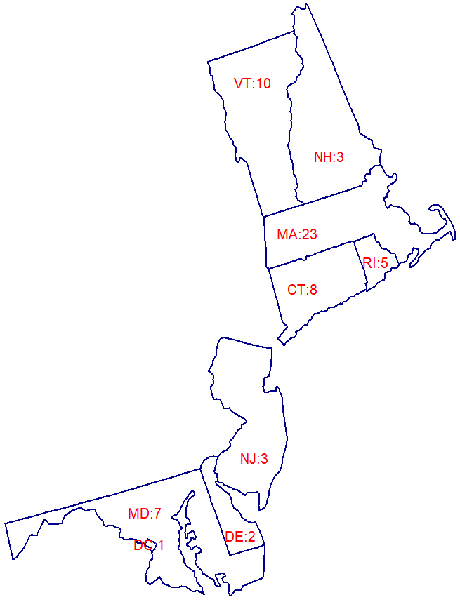
Brewery Count per State
Top 5 States
Colorado (CO) | 47
California (CA) | 39
Michigan (MI) | 32
Oregon (OR) | 29
Texas (TX) | 28

Slide 5
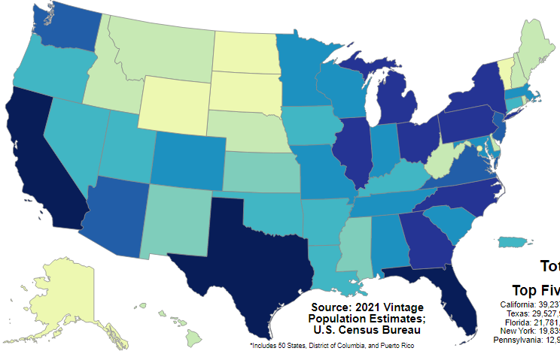
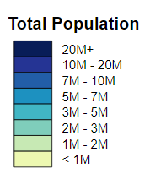
Population Count per State

Slide 6
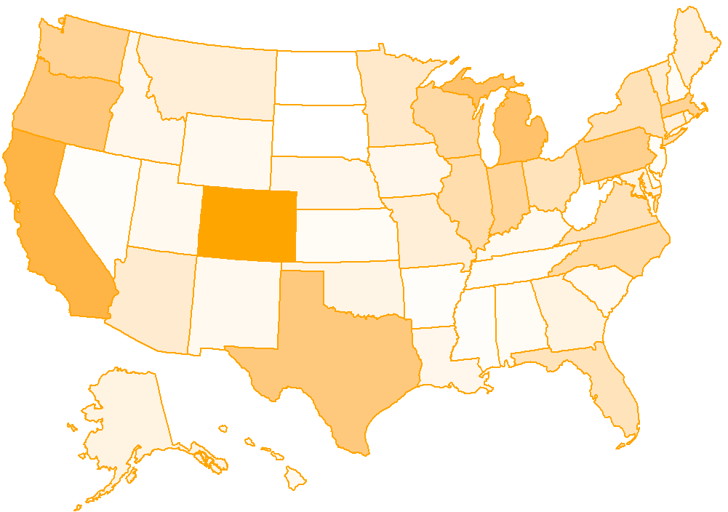
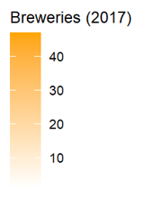
Brewery Density per State

Slide 7
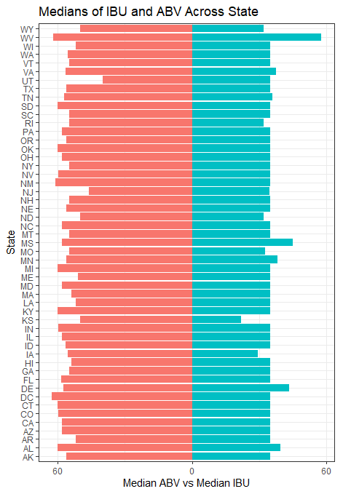
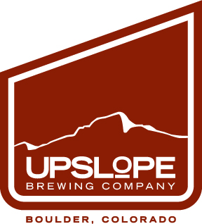

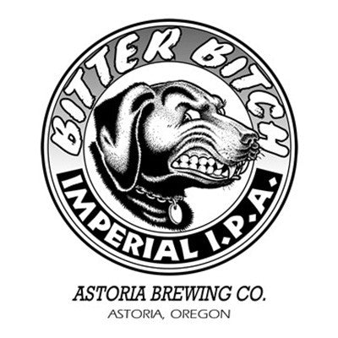
Beer Descriptors per State
ABV versus IBU
Maximum Alcohol by Volume:
Beer: Lee Hill Series Vol. 5
Brewery: Upslope Brewing Company
State: Colorado
Washington DC has the highest median ABV.
Maximum International Bitterness Unit:
Beer: Bitter Bitch Imperial IPA
Brewery: Astoria Brewing Company
State: Oregon
West Virginia has the highest median IBU.

Slide 8
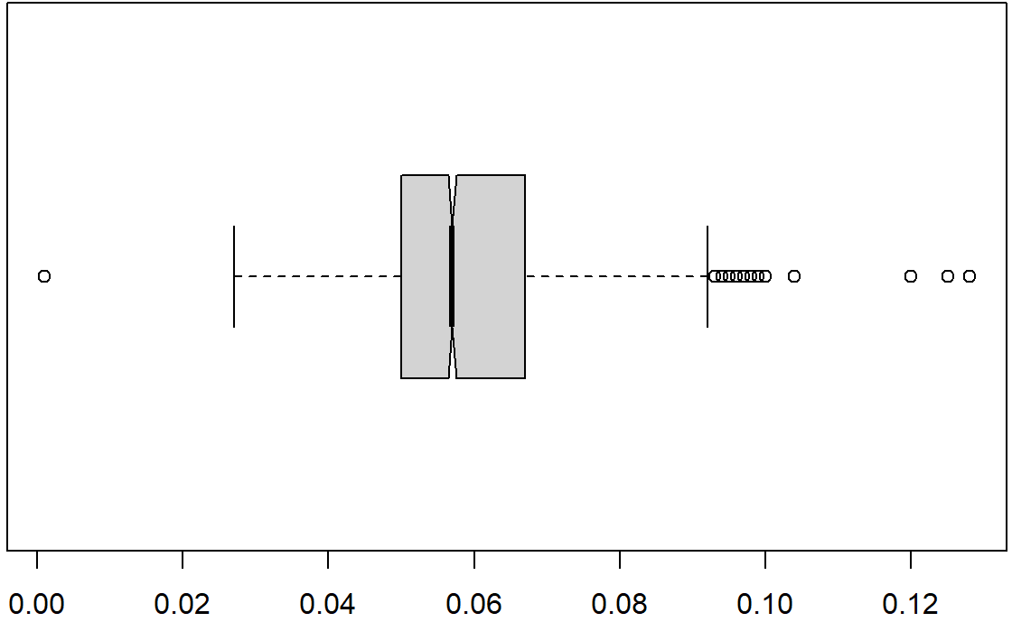
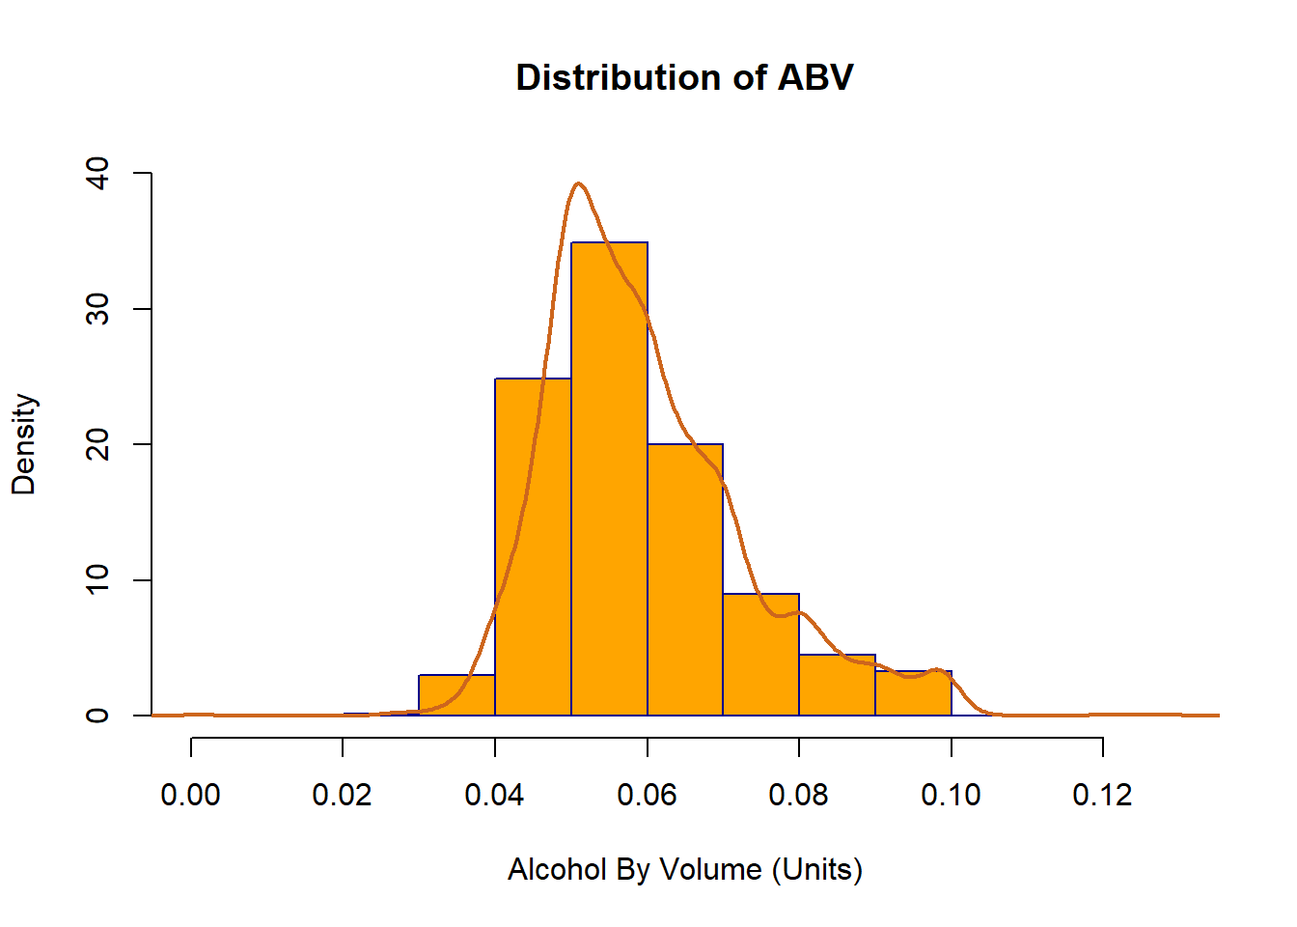
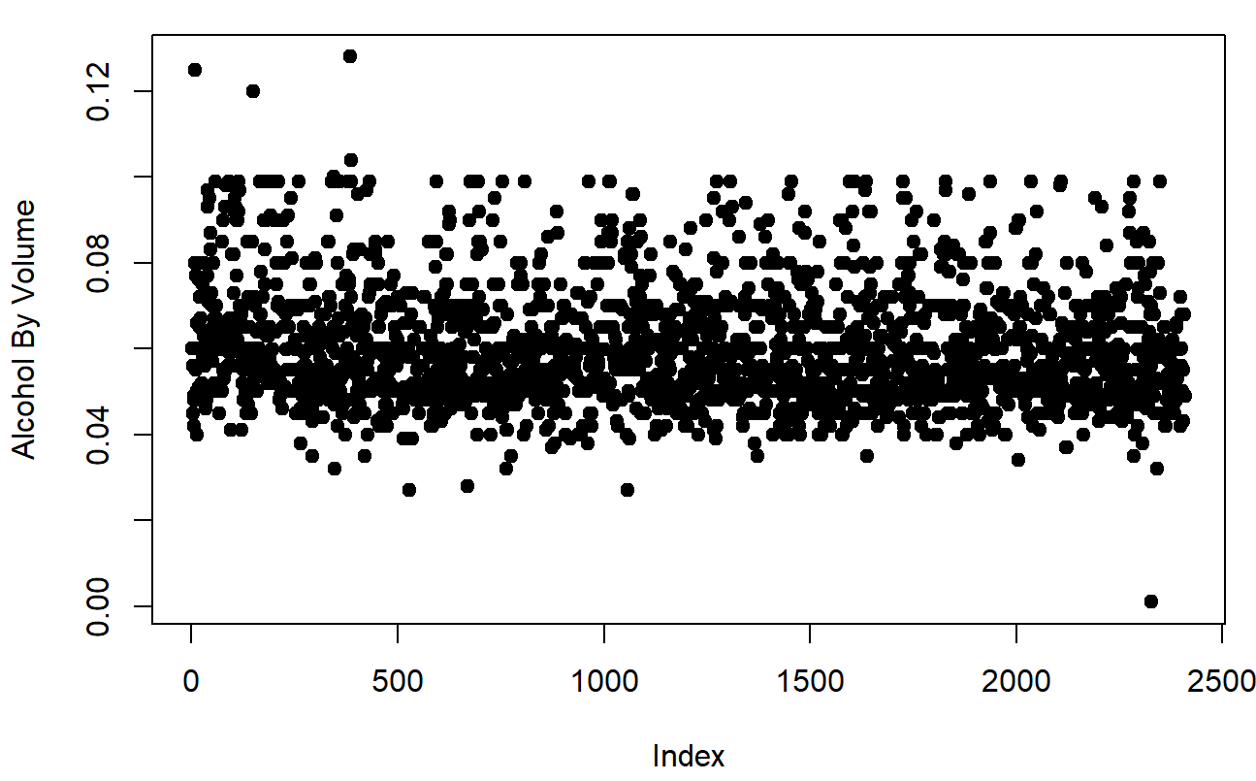
Nationwide Statistics
Boxplot Version
Alcohol by Volume (Units)
Observations: 2410
Mean: 0.05977
Median: 0.05700
SD: 0.01336
1st Quarter: 0.05000
3rd Quarter: 0.06700
Scatterplot Version

Slide 9
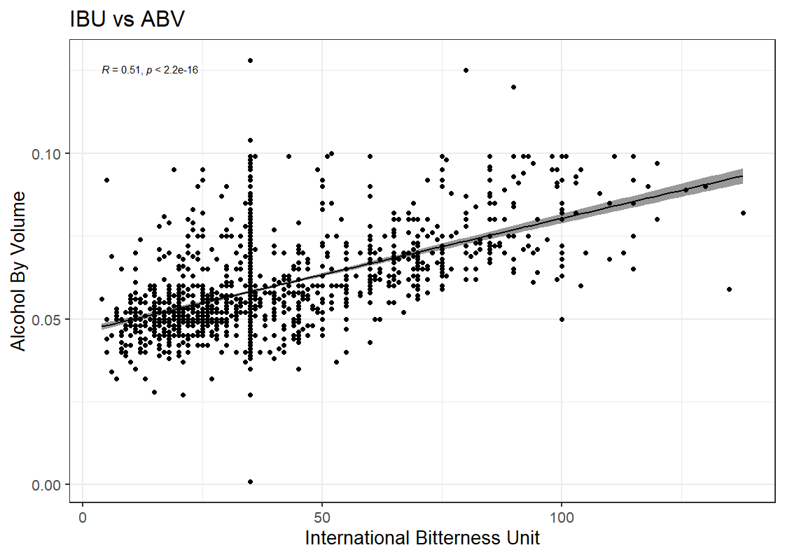
Relationship between ABV and IBU

Slide 10
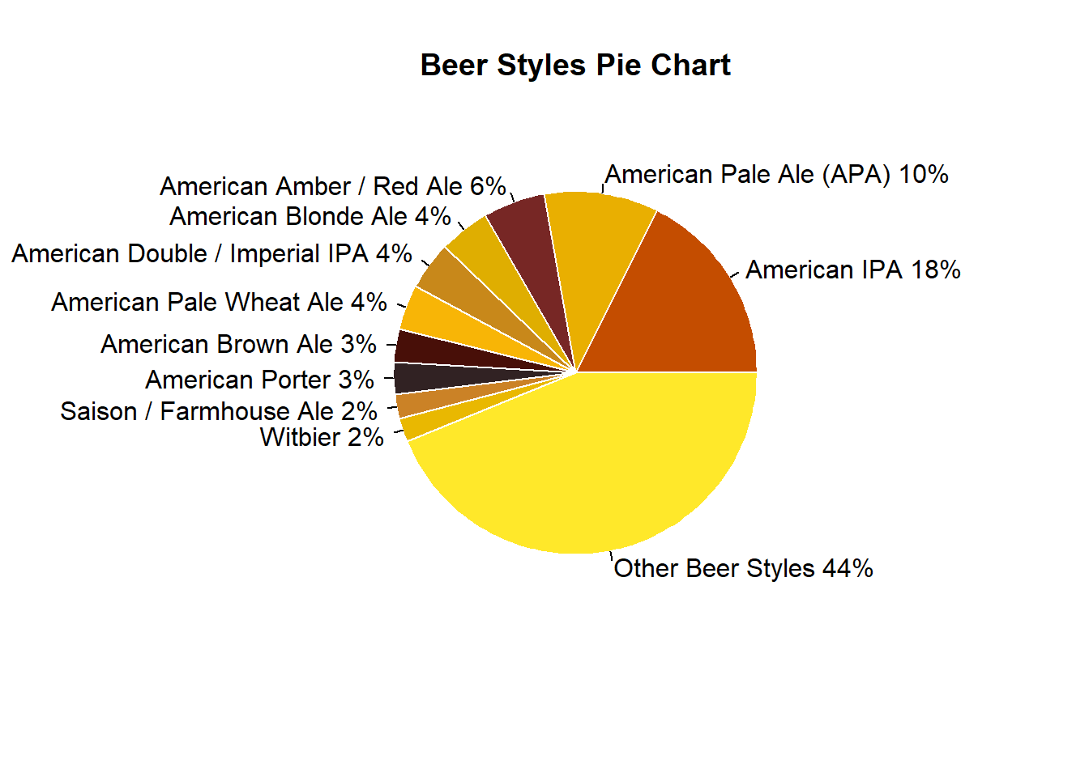
Beer Styles and Their Market Percentage
Top 10 Beer Styles
American IPA | 424
American Pale Ale | 245
American Amber / Red Ale | 133
American Blonde Ale | 108
American Double / Imperial IPA | 105
American Pale Wheat Ale | 97
American Brown Ale | 70
American Porter | 68
Saison / Farmhouse Ale | 52
Witbier | 51
Other Beer Styles | 1057
Total | 2410

Slide 11
Thank You.
Duy Nguyen & Garrett Shankel
duynq@mail.smu.edu
gshankel@mail.smu.edu

Slide 12
Presentation Video Link
Garrett Shankel - https://youtu.be/F2KTOjOjZYg

